Slide 1

GUPSHUP
// March 2021
Discussion Forum
How to start programming?
Python…

Slide 2
Kashish Harisinghani
1911016
Harshit Jain
1911017
Rushabh Gandhi
1911012

Slide 3

Contents
Problem Definition
Objective
Literature survey
Architecture diagram
Functionalities
Implementation details
UI designs
Future Scope

Slide 4

PROBLEM DEFINITION
Making a discussion forum for an institute where students and teachers can ask, and answer any of the questions asked by other members of the institute, also having some possibility to form a community of liked-minded people so that the questions can be answered according to the area of interest.

Slide 5

OBJECTIVE
Generally a college or an institute does not have a place where the students as well as the faculty can come together and can discuss ideas and thoughts. Sometimes the problems can be just solved by mere discussion with someone but the lack of resources, guidance, knowledge and a suitable platform hinders this process of sharing and learning. This website aims to provide a solution for the given problem in an efficient and accurate method.

Slide 6
DELIVERABLES
Python executable code
css code files
read me file
javascript code files
user guide video
List of features
html code files
Project presentation

Slide 7
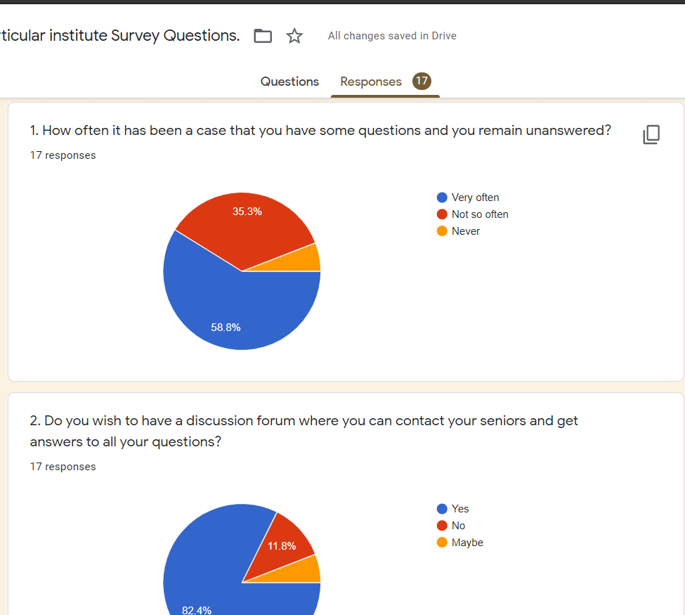
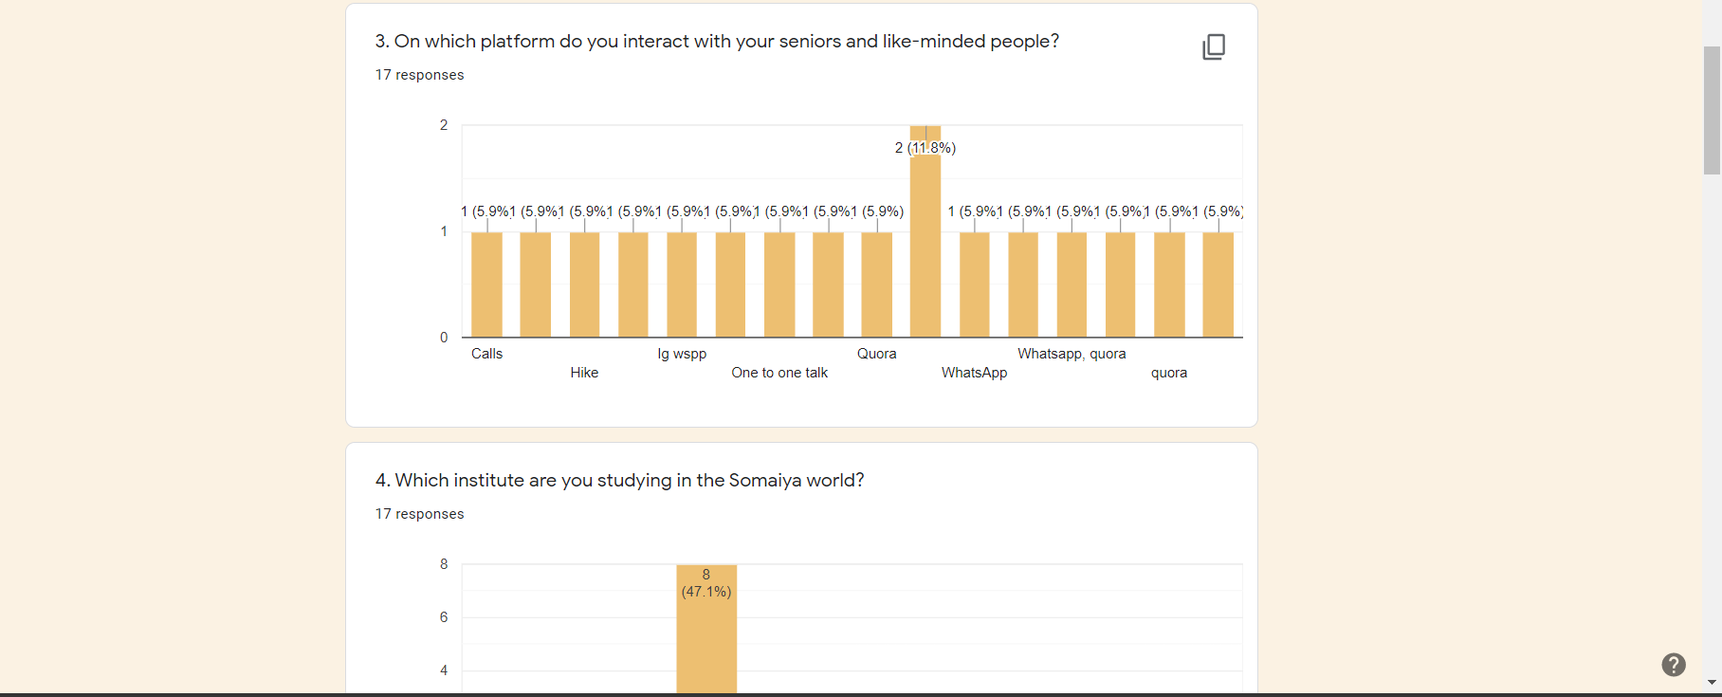
Literature Review
Link to Google Form

Slide 8
Statistics From Survey
63.3%
81.8%
45.5%
Unanswered
Need
Like
Questions remain unanswered
Needed Discussion forum
Like to read and write blogs related to college life

Slide 9
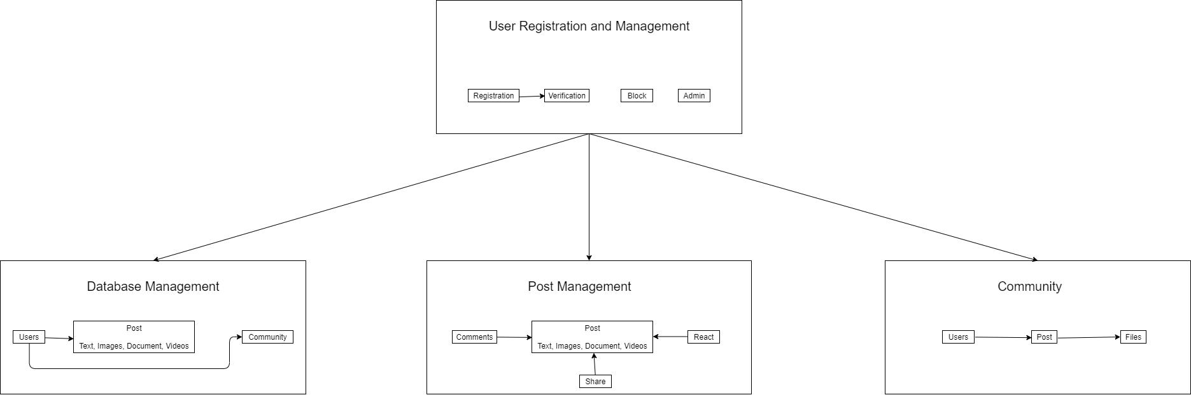
Architecture Diagram

Slide 10
UPTIL NOW ON GUPSHUP
User App
Integration
UI Templates
Post App

Slide 11

FUNCTIONALITIES

Slide 12

Functionalities
Login into the web portal using a unique id.
Adding blogs to the website.
Question answer-based forum.
Writing comments for other posts.
Answering a question.
Upvote and downvote
Segregating the posts based on different categories.

Slide 13
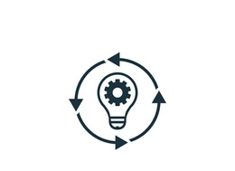
IMPLEMENTATION DETAILS

Slide 14
Post App
Laid the pipeline of the app in urls.py.
Made class based and function based views in views.py.
Worked on UI templates.
Developed forms for new posts in forms.py.
Established entities and fields for post app in models.py.

Slide 15
User App
Added user authentication functionalities.
Laid the pipeline of the app in urls.py.
Made class based and function based views in views.py.
Worked on UI templates.
Developed forms for new posts in forms.py.
Utilized signals for updating profile.
Established entities and fields for post app in models.py.

Slide 16
Integration of the Apps
Both apps could not run individually and needed to be fused together for a rich UI experience. Hence we took help of Django documentation and various sites like the medium and stackoverflow to achieve the amalgamation of both the apps.

Slide 17

AN IMAGE IS WORTH A THOUSAND WORDS

Slide 18
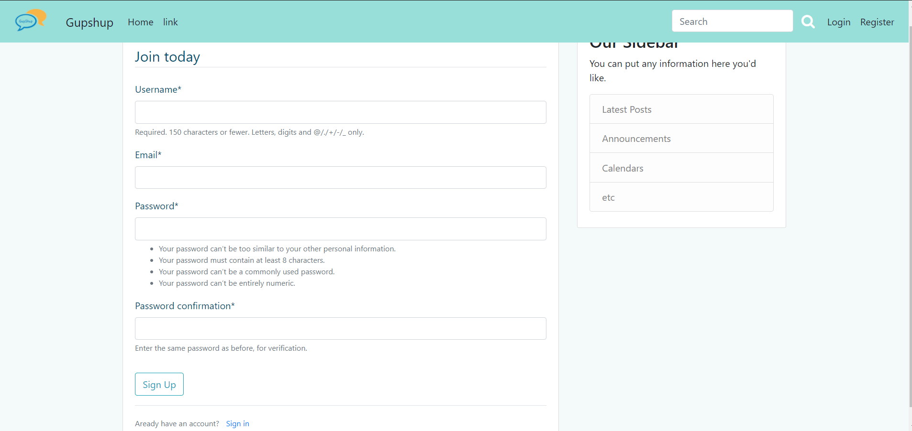
01. Login and Register

Slide 19
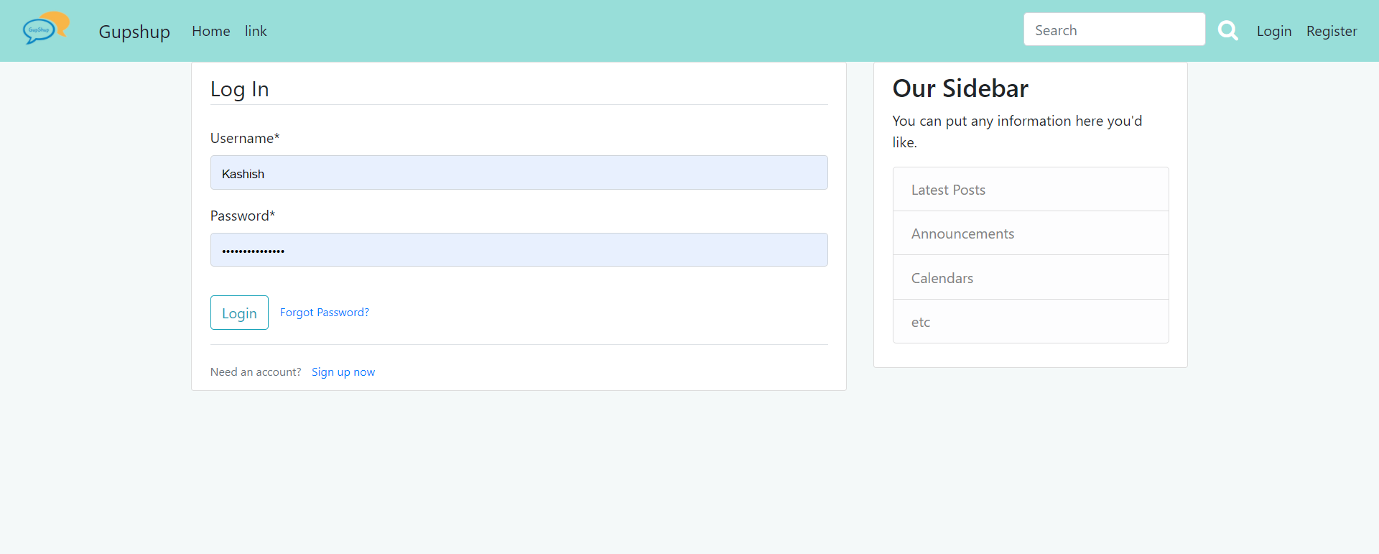
02. Login

Slide 20
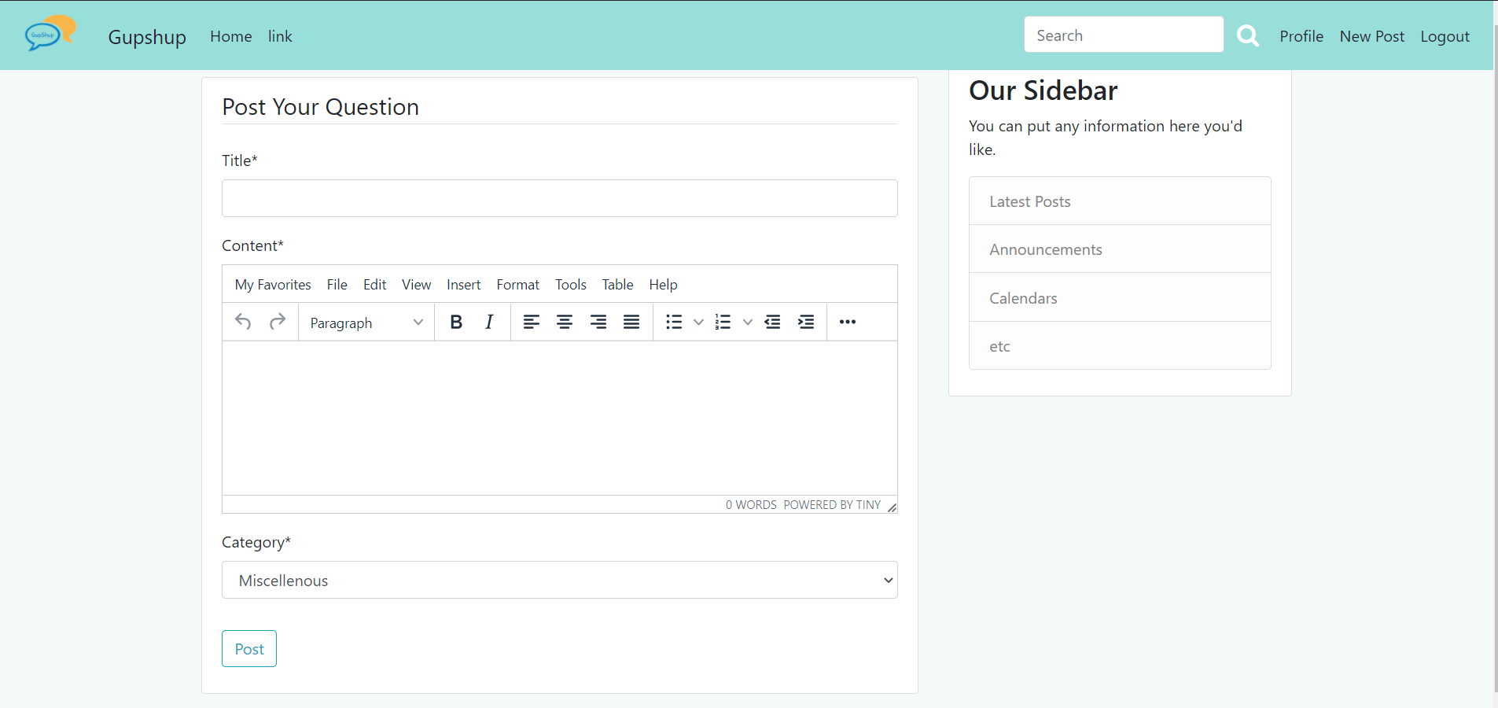
03. New Post

Slide 21
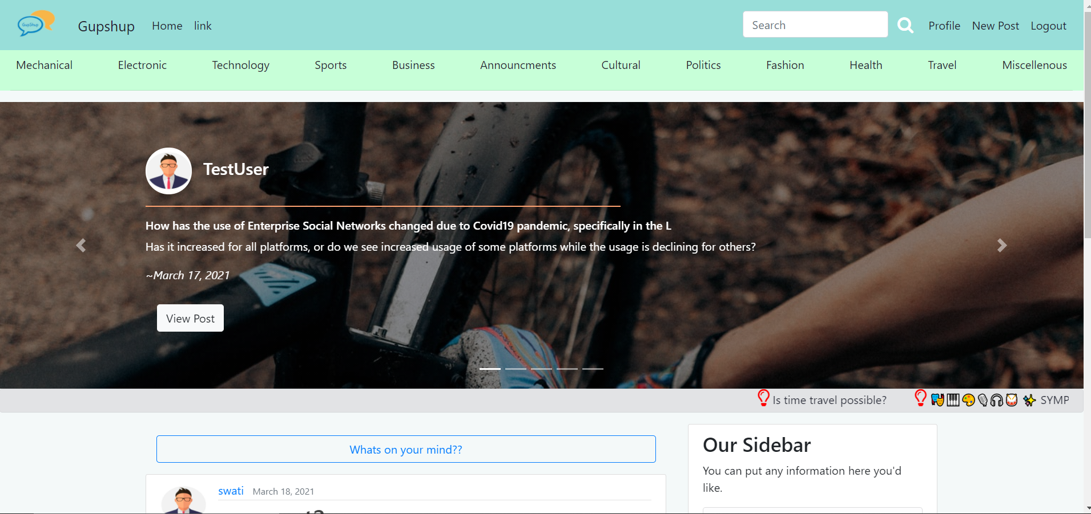
04. Landing(1)

Slide 22
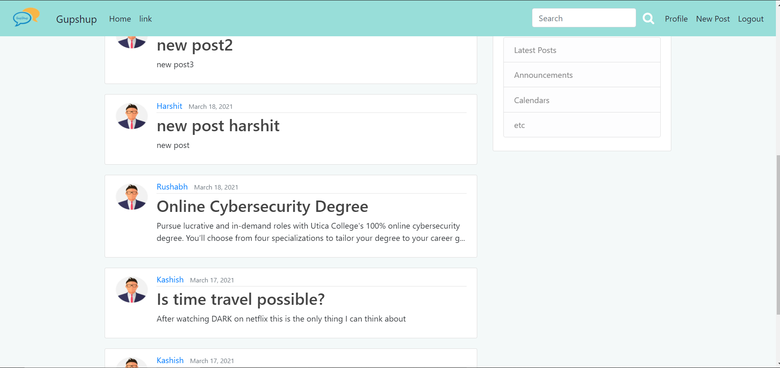
04. Landing(2)

Slide 23
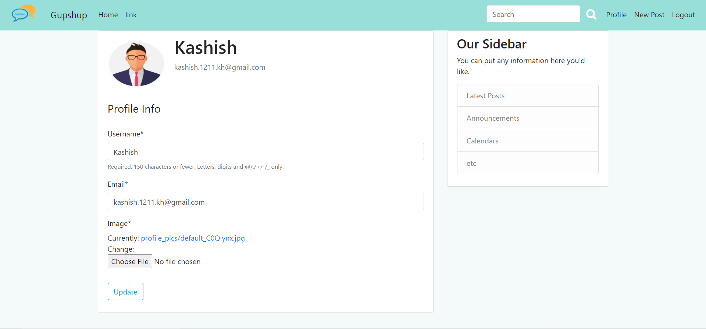
05. Profile

Slide 24
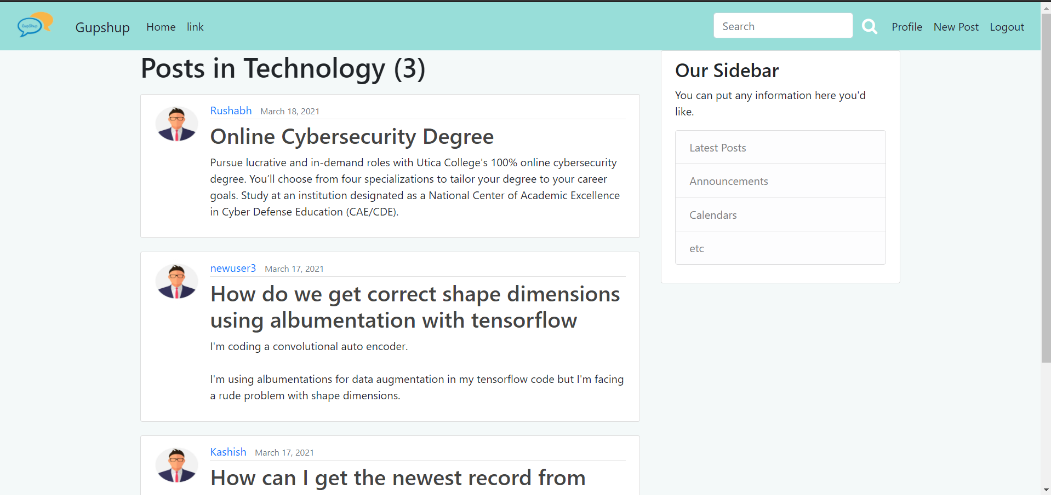
06. Category-wise Posts

Slide 25
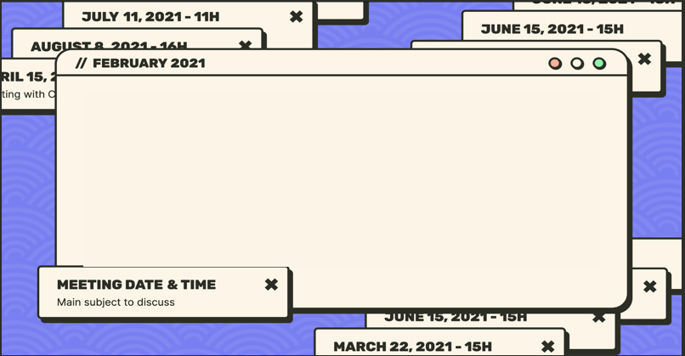

Github Link
https://github.com/kashish1211/GUPSHUP

Slide 26
Future Scope
Trust rating of user
Private Chat
Sharing of post
Bookmark a post
Recommendation System

Slide 27
References
https://docs.djangoproject.com/en/3.1/
https://getbootstrap.com/docs/4.0/getting-started/introduction/
https://developer.mozilla.org/en-US/docs/Web/JavaScript
https://tailwindcss.com/
https://stackoverflow.com/
https://www.geeksforgeeks.org/

Slide 28
THANK YOU!
Signing off
DO YOU HAVE ANY QUESTIONS?
youremail@freepik.com
+34 654 321 321
yourwebsite.com
Please keep this slide for attribution

